Slide 1
Student Details
Name: PALURI SAI SREE
SkillsBuild email-id : 20981a4442@raghuenggcollege.in
College name:
RAGHU ENGINEERING COLLEGE
Internship domain and Internship Start and End Date:
Data Analytics
From 08-Jun-2023 to 15-July-2023

Slide 2
Project Title / Problem Statement
Title:
“Doctor Visit Analysis”
Problem Statement: Load the dataset , perform cleaning on the dataset and also explore the data and extract useful insights from this data using data visualization techniques in python.

Slide 3
AGENDA
So the main agenda of my Project is:
Data Cleaning
Data exploring
Data Visualization

Slide 4
PROJECT OVERVIEW
The purpose of this project is to extract meaningful insights and knowledge from raw data. This involves examining , cleaning, discovering patterns ,relationships.
The scope of data analysis is broad and can be applied to various domains and industries . With advancements in technology and increasing availability of data, the scope of data analysis continues to expand.

Slide 5
WHO ARE THE END USERS of this project?
A data can provide many useful insights for people in the following fields:
Business executives and managers
Data scientists
Researchers and scientists
Marketing and Sales Professionals
Government and Policy Makers
Financial Analysts and Planners
Healthcare Professionals
These are just a few examples . In reality data analysis can benefit professionals and organizations who have a need for insights to support decision making ,problem solving and performance improvement.

Slide 6
YOUR SOLUTION AND ITS VALUE PROPOSITION
As the task was to analyze the data and extract useful insights from it I used google colab to analyze the dataset provided.
I loaded the dataset in the google colab using pandas library and explored the dataset using some build-in methods like describe, info, head etc.
Then I cleaned the data by multiplying age column by 100 because the age was in float values.
Then I used matplotlib library to visualize the data using different graphs like bar, plot, pie chart.

Slide 7
How did you customize the project and make it your own
There are some key features which makes my project unique which are mentioned as follows:
Patient visit analysis ( visits based on gender , age , illness) : My project leverages data on visits, gender, age, illness to analyze patient visit patterns . By understanding these factors healthcare organization can customize their services and improve healthcare delivery.
Income and Affordability Assessment (financial status of patients) : My Project incorporates income data to assess the financial status of patients. By analyzing income levels in relation to visits organizations can identify opportunities to offer discounted services.
Health Insurance Utilization ( Type of health insurance (private or govt)): The project analyzes private column which represents health insurance coverage to evaluate impact of insurance on patient visits.

Slide 8
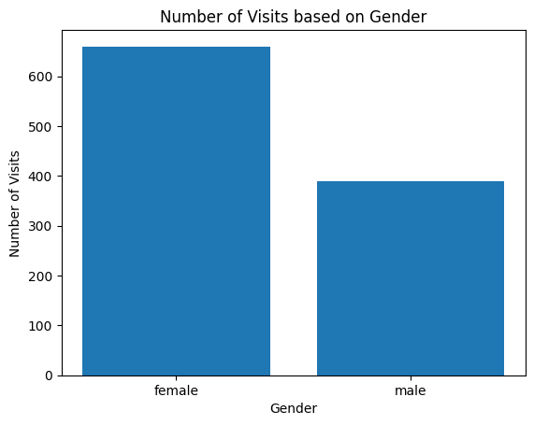
MODELLING
I used libraries like Matplotlib and seaborn to visualize the data and after applying these libraries in use I got the following graphs:

Slide 9
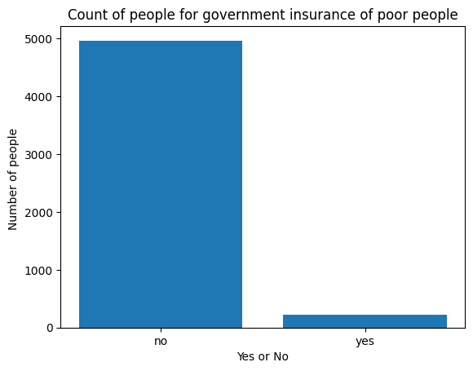
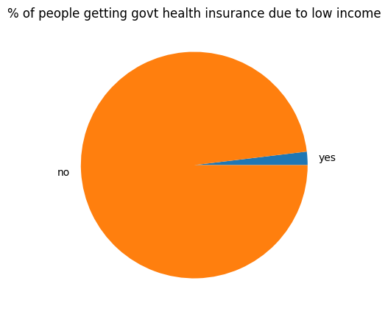
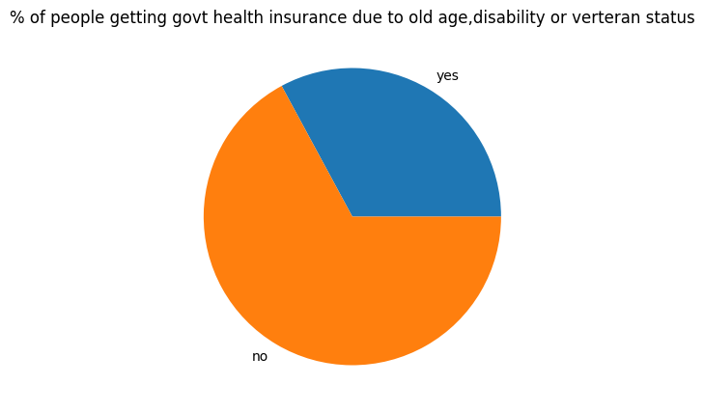

Slide 10
Results
After Performing all the steps of analysis i.e. cleaning , exploring , analyzing, visualizing this data is sent to the end users who can get benefits from these insights as these insights help in making better decisions for their company .
All these results are shown in the project vividly.

Slide 11
Links
Google Drive link for the project in pdf format:
https://drive.google.com/file/d/1gt8glGeQ2fBkw6DwqyxcP_-iBIJOZU-o/view?usp=sharing

Slide 12


